Slide 1
USE XSLT WITH SWORD
Name Referent
Title/ Function
Corporate Customer & Enterprise Integration
Date

Slide 2
Seq | Item
1 | Name Conventions
2 | Structure of file system
3 | Restrictions
4 | Configuring the Process steps
5 | Configuring the MBC
6 | Dynamic tables
7 | Using references
8 | SVN

Slide 3
Name Conventions
Please use names like for Datamapper mappings:
“_” to separate the parts
Example:
E_XSLT_DURAE2MMSG.xslt
Please do not use the extension “*.xsl”!
Part1 | Part2 | Part3 | Part4
Region | Fix “XSLT” | Name of the mapping (normally like process ID) | Extension “.xslt”

Slide 4
Structure of file system
Directory | Function
/app/sword/schenker/data/xslt/maps | Mapping depository
/app/sword/schenker/data/xslt/dynamic_tables | Dynamic tables depository
/app/sword/schenker/data/xslt/from_xib | Directory where xib hands over files to the xslt processor
/app/sword/schenker/data/xslt/to_xib | Directory where the xslt processor hands over files to xib

Slide 5
Restrictions
One xslt mapping is always just one file. It is not allowed to include external templates (because of the svn-concept and to keep it simple). The usage of external tables is of course possible.
One incoming file has just one BDID
One incoming file creates exactly one outgoing file
Dynamic tables have to be addresses with a relative path (like “../dynamic_tables/<table>”)
Only to be used in parallel flows
Only to be used in the dynamic stage
Files should not be bigger than 10MB

Slide 6
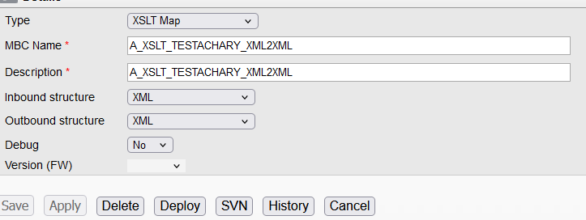
Configuring the Process Setups
Type: select XSLT Map
MBC Name: same with XSLT mapping name without extension
Description: mapping description
Inbound/Outbound structure: select the file type for inbound/outbound
Debug: default No

Slide 7
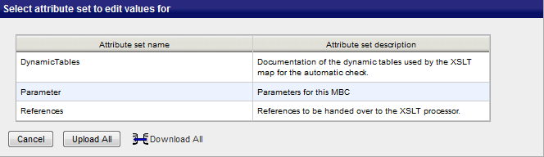
Configuring the MBC
The name of the xslt MBC is MO_XSLTProcessor. You can define the following three categories:

Slide 8
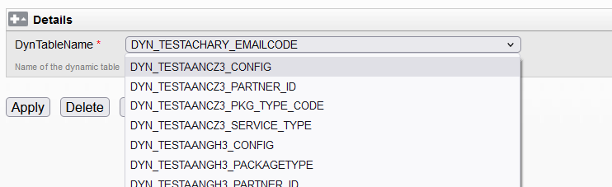
Configuring the MBC
a. Dynamic tables
This category is optional. Only if you want to use a dynamic table in your mapping, you have to define it here. It is a dropdown of the existing dynamic tables. So you have to create the tables in the configurator first.

Slide 9
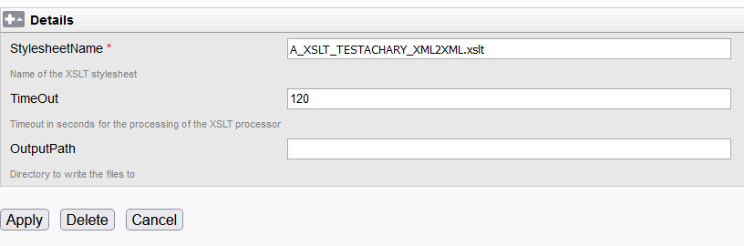
Configuring the MBC
b. Parameter
This category is mandatory. In this category you define the following parameters:
Parameter | Value | Mandatory
StylesheetName | The name of your xslt mapping in /app/sword/schenker/data/xslt/maps | Yes
TimeOut | Time in seconds to wait for the conversion before throwing an error. Default is 120. Shouldn´t be changed in most of the cases. Note: If the xslt-processor finishes the transformation after the timeout value was reached, SWING will show “success with error”. | Yes
OutputPath | Future enhancement. Please leave this value empty | No

Slide 10
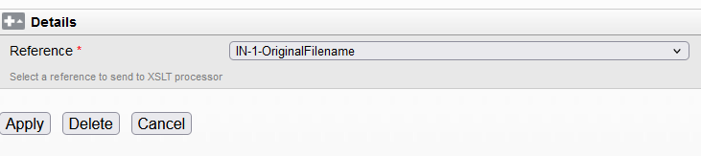
Configuring the MBC
c. Reference
This category is optional. If you want to use framework references inside your mapping, you have to select them here once (every reference individually).

Slide 11
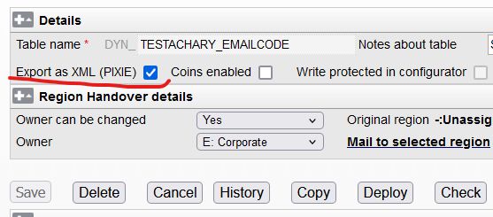
Dynamic tables
a. Create tables
It is same with the tables use in datamapper, but keep the Export as XML(PIXIE) checkbox selected while creating tables in Configurator.

Slide 12
Dynamic tables
b. Usage
The dyn. table dump has to be stored relatively to the mapping in "../dynamic_tables".
There are two ways to address dyn. tables in xslt:
(1)Reading the complete table into one Variable in the stylesheet:
<xsl:variable name="vendor" select="document('dynamic_tables/DYN_AMATE2AEAN_VENDOR.xml)"/>
Then you can access the content like:
<xsl:value-of select="$vendor/table_dump/row[AMAT=’6194’]/PROCARS"/>
Should be used if there are multiple accesses to the table, because table is hold in ram.

Slide 13
Dynamic tables
b. Usage
(2)Accessing the table directly:
<xsl:value-of select="document('/dynamic_tables/DYN_AMATE2AEAN_VENDOR.xml)/table_dump/row[AMAT=’6194’]/PROCARS"/>

Slide 14
Using Reference
a. Use framework references in xslt
You can use the values of the references, that you have selected in the MBC configuration directly as variables. The notation for those variables is lower case and with “_” instead of “ “.
For example if you have a reference in the framework, that is called “Document ID”, you can address it as follows: <xsl:value-of select="$document_id"/>
Examples:
The BDID can be addressed in any case as $bdid (<xsl:value-of select="$documentid"/>).
Framework Reference | Code
Document ID | <xsl:value-of select="$document_id"/>
DocumentID | <xsl:value-of select="$documentid"/>
Awesome_Ref Name | <xsl:value-of select="$awesome_ref_name"/>

Slide 15
Using Reference
b. Create framework references in xslt
To send references from the xslt mapping back to the framework, you have to build the following code (recommended at the end of the main template):
<xsl:result-document href="metaout">
<references_out>
<reference name="<reference name>" sequence="<reference number>" structure_name="Dynamic_XSLT">
<value>
</reference>
</references_out>
</xsl:result-document>
The yellow marked text defines the reference name and number (it is always part1).
The green marked text is the value of your reference.

Slide 16
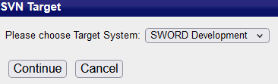

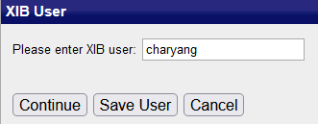

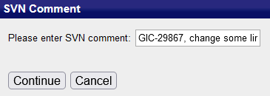
SVN Check In
1. Always select sword development 4. click ‘浏览’ button
2. Developer account 5. select your xslt mapping and click Upload File
3. Write the comments here

